Slide 1

Neuroheart AI
The AI-powered mental wellness platform transforming workplace wellbeing

Slide 2

The Workplace Mental Health Crisis
74%
27%
of Fortune 500 employees report stress as their primary concern
experience symptoms of anxiety affecting their work and personal life
Traditional mindfulness apps fall short because they rely on static, pre-recorded content that cannot adapt to your employees' real-time mental and emotional states. The result? Limited engagement and minimal long-term impact on workplace wellness.

Slide 3
Two Mental States That Define Performance
Breakdown State
Breakthrough State
Triggered by shock, stress, or trauma, this state creates a downward spiral. Negative emotions intensify while cognitive performance—thinking, memory, attention, and reasoning—declines progressively.
A mental condition of renewal and balance where emotional tension releases, clarity returns, and inner coherence strengthens over time.
The virtuous cycle: Calm fuels clarity, clarity fuels action, and action reinforces emotional stability and sustainable growth.
The vicious cycle: Stress fuels emotional and mental fatigue, gradually deepening into burnout or depression.

Slide 4

Moving from breakdown to breakthrough is the key to reducing workplace stress

Slide 5
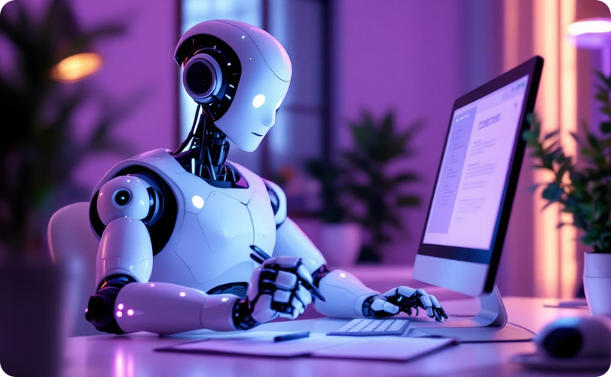
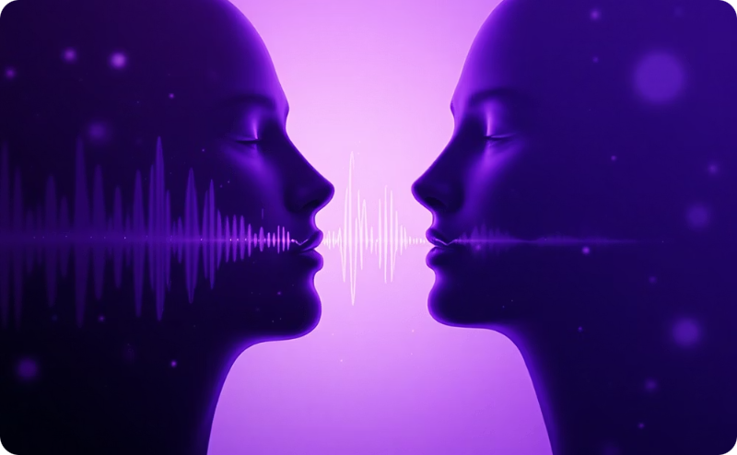

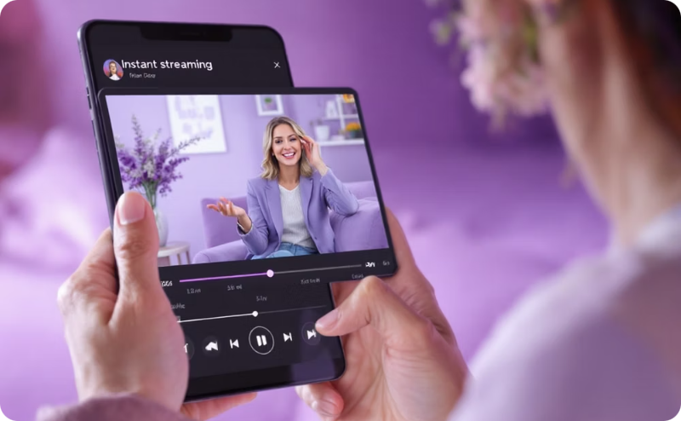
Auto-Script from AI Response
Seamless TTS Conversion
Dynamic Guidance
Instant Playback & Hosting
Neuroheart APP generates a customized meditation based on chat history and HRV analysis
The most recent AI-generated message is automatically used as the input script for video generation.
ElevenLabs converts the script into lifelike speech before initiating video rendering.
Meditation playlist shows audio history.

Slide 6
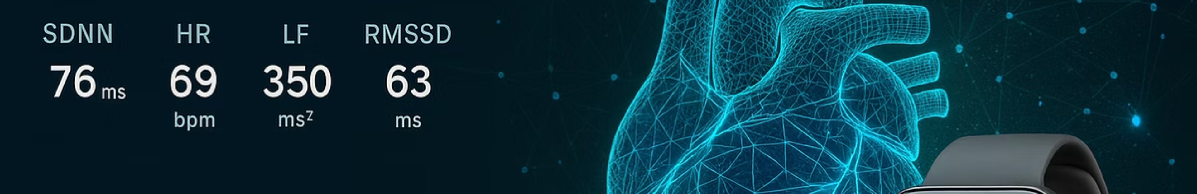
Introducing Neuroheart AI
Neuroheart AI is a revolutionary platform that guides users into breakthrough high-performance states through a GPT-5 powered mindfulness chatbot. Unlike static apps, our technology responds dynamically to each individual's unique mental and emotional needs in real time.
01
02
AI-Powered Voice Guidance
Memory Backtracking
Generates personalized mindfulness sessions with background music on the fly
Helps identify key stressors through contemplative practice
03
04
Emotional Processing
Breakthrough Transformation
Peak emotions are consciously observed and processed
Mental system shifts into a virtuous cycle of growth and performance

Slide 7
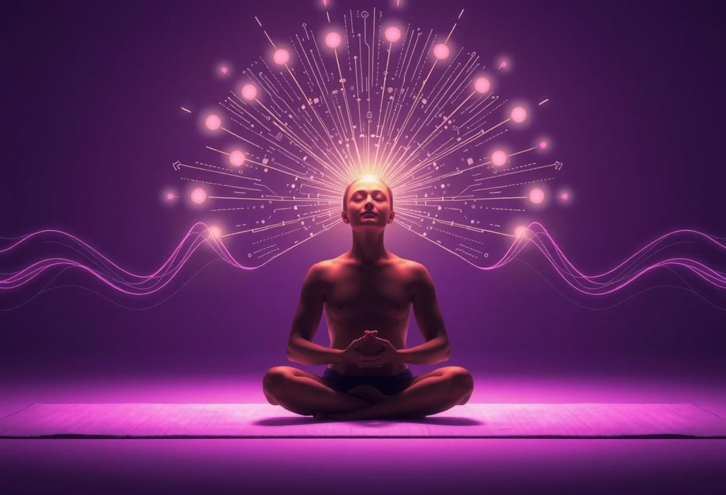


Proven Results: Campus Study
An on-campus study involving fifteen engineering students demonstrated transformative outcomes that validate our approach to mental wellness.
59.37%
Stress Reduction
Substantial decrease in reported stress levels
The SDNN increased by 40.63 % indicating enhanced physiological relaxation
15.84%
Heart Coherence Increase
Measurable improvement in cardiovascular harmony
These results show the power of AI-driven, personalized mindfulness in creating lasting mental wellness improvements.

Slide 8
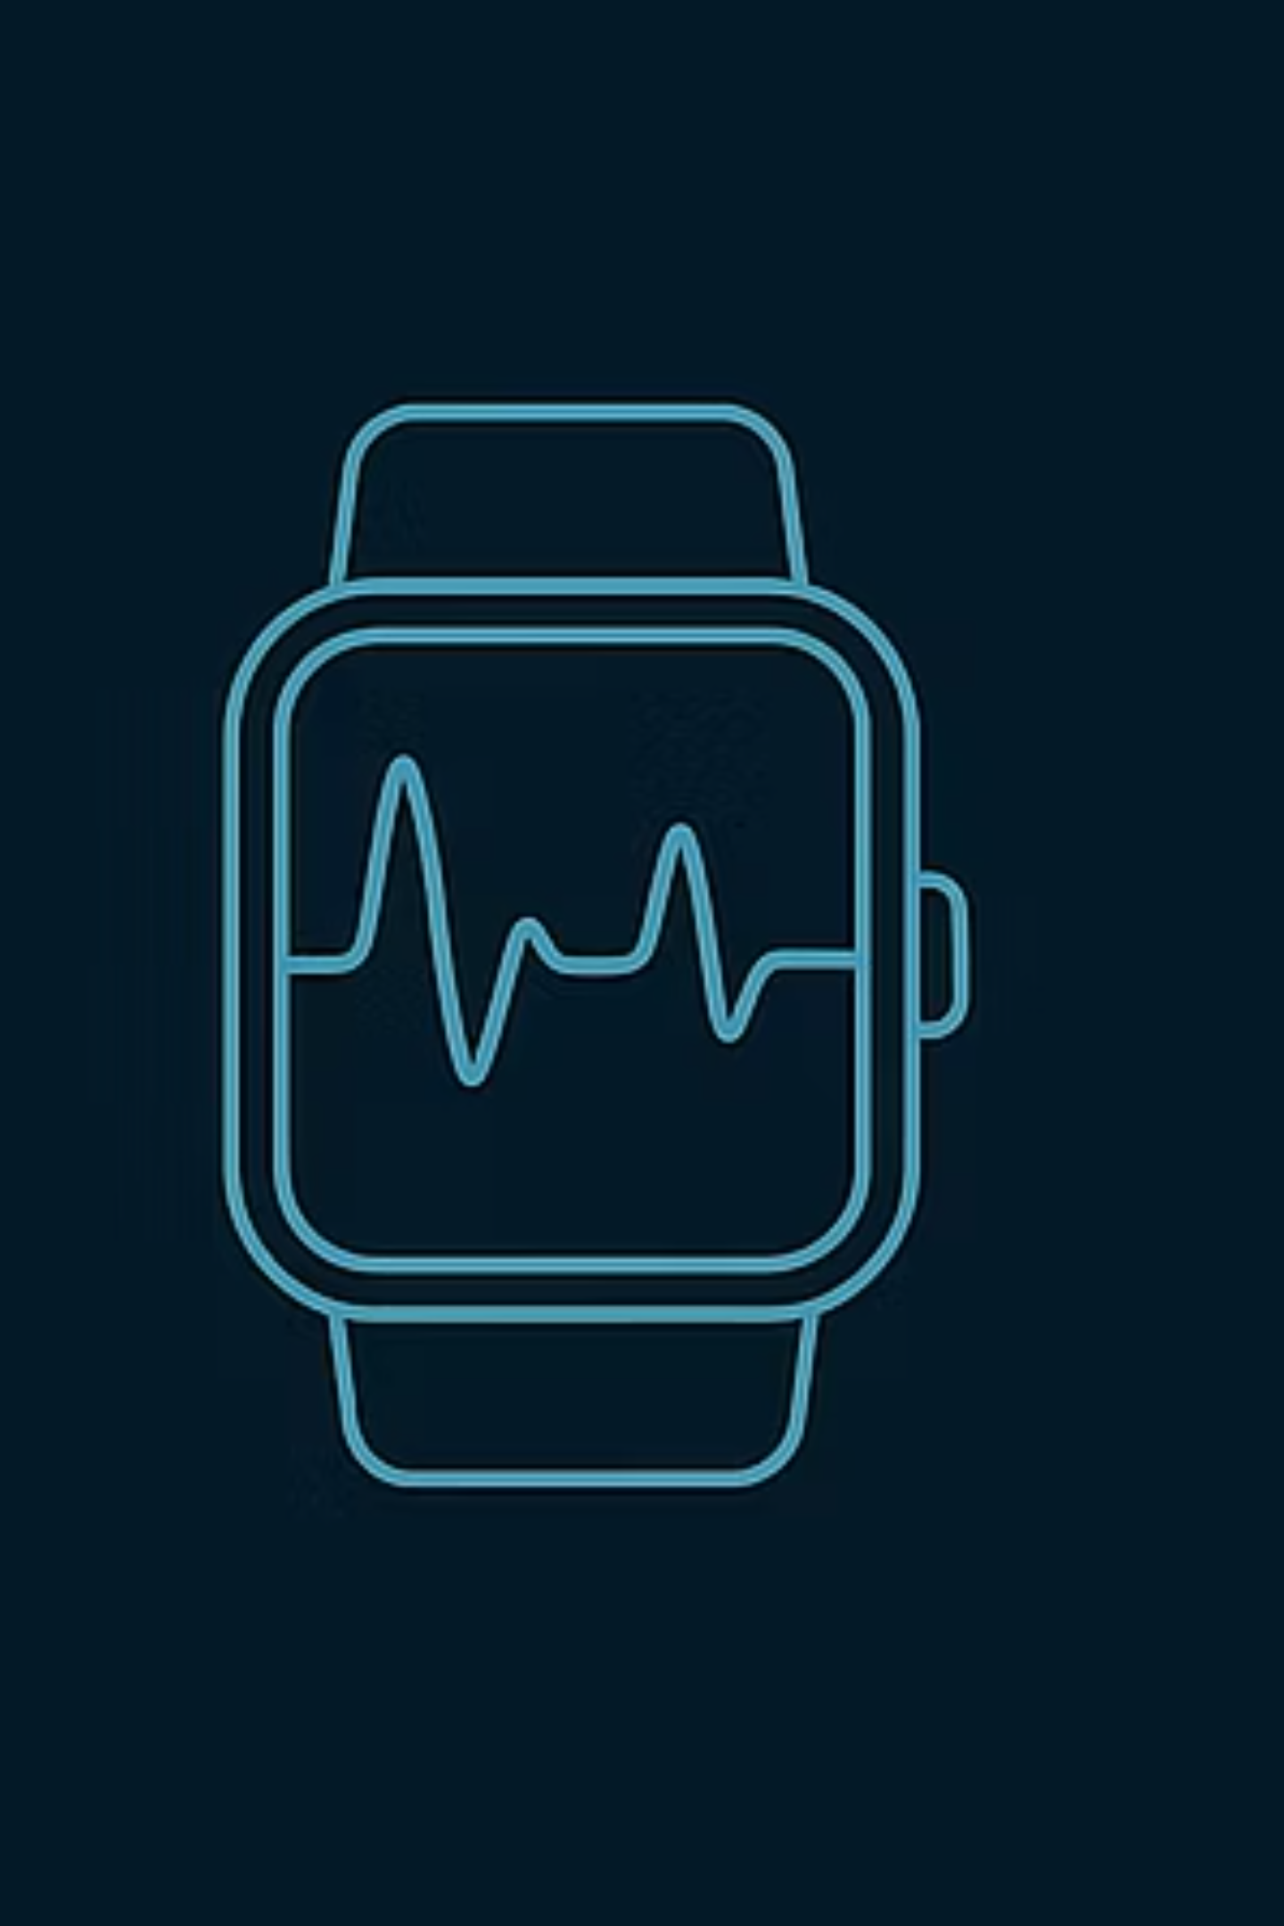
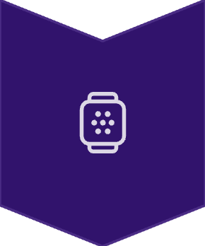
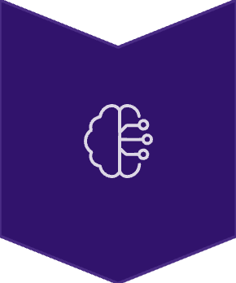

Advanced Heart Rate Variability Monitoring
Heart Rate Variability (HRV) is the gold standard for measuring mental and emotional balance. Neuroheart AI continuously monitors and processes HRV from smartwatch pulse data, revealing subtle shifts with precision.
Continuous Monitoring
Real-time HRV data from wearable devices
Intelligent Analysis
Chat interactions, mood detection, and emotional trends
Actionable Insights
Research-backed algorithms generate personalized practices

Slide 9

Why Neuroheart AI for Enterprises
Personalized & Adaptive
Evidence-Based
GPT-5 powered technology responds to real-time mental states, not static recordings
Built on research-backed HRV analysis and proven mindfulness methodologies
High Performance Focus
Seamless Integration
Shifts employees from breakdown to breakthrough states for sustainable productivity
Works with existing smartwatch technology your employees already use
Measurable Impact
Always Available
Track stress reduction and mental wellness improvements across your workforce
On-demand support whenever employees need mental wellness guidance

Slide 10
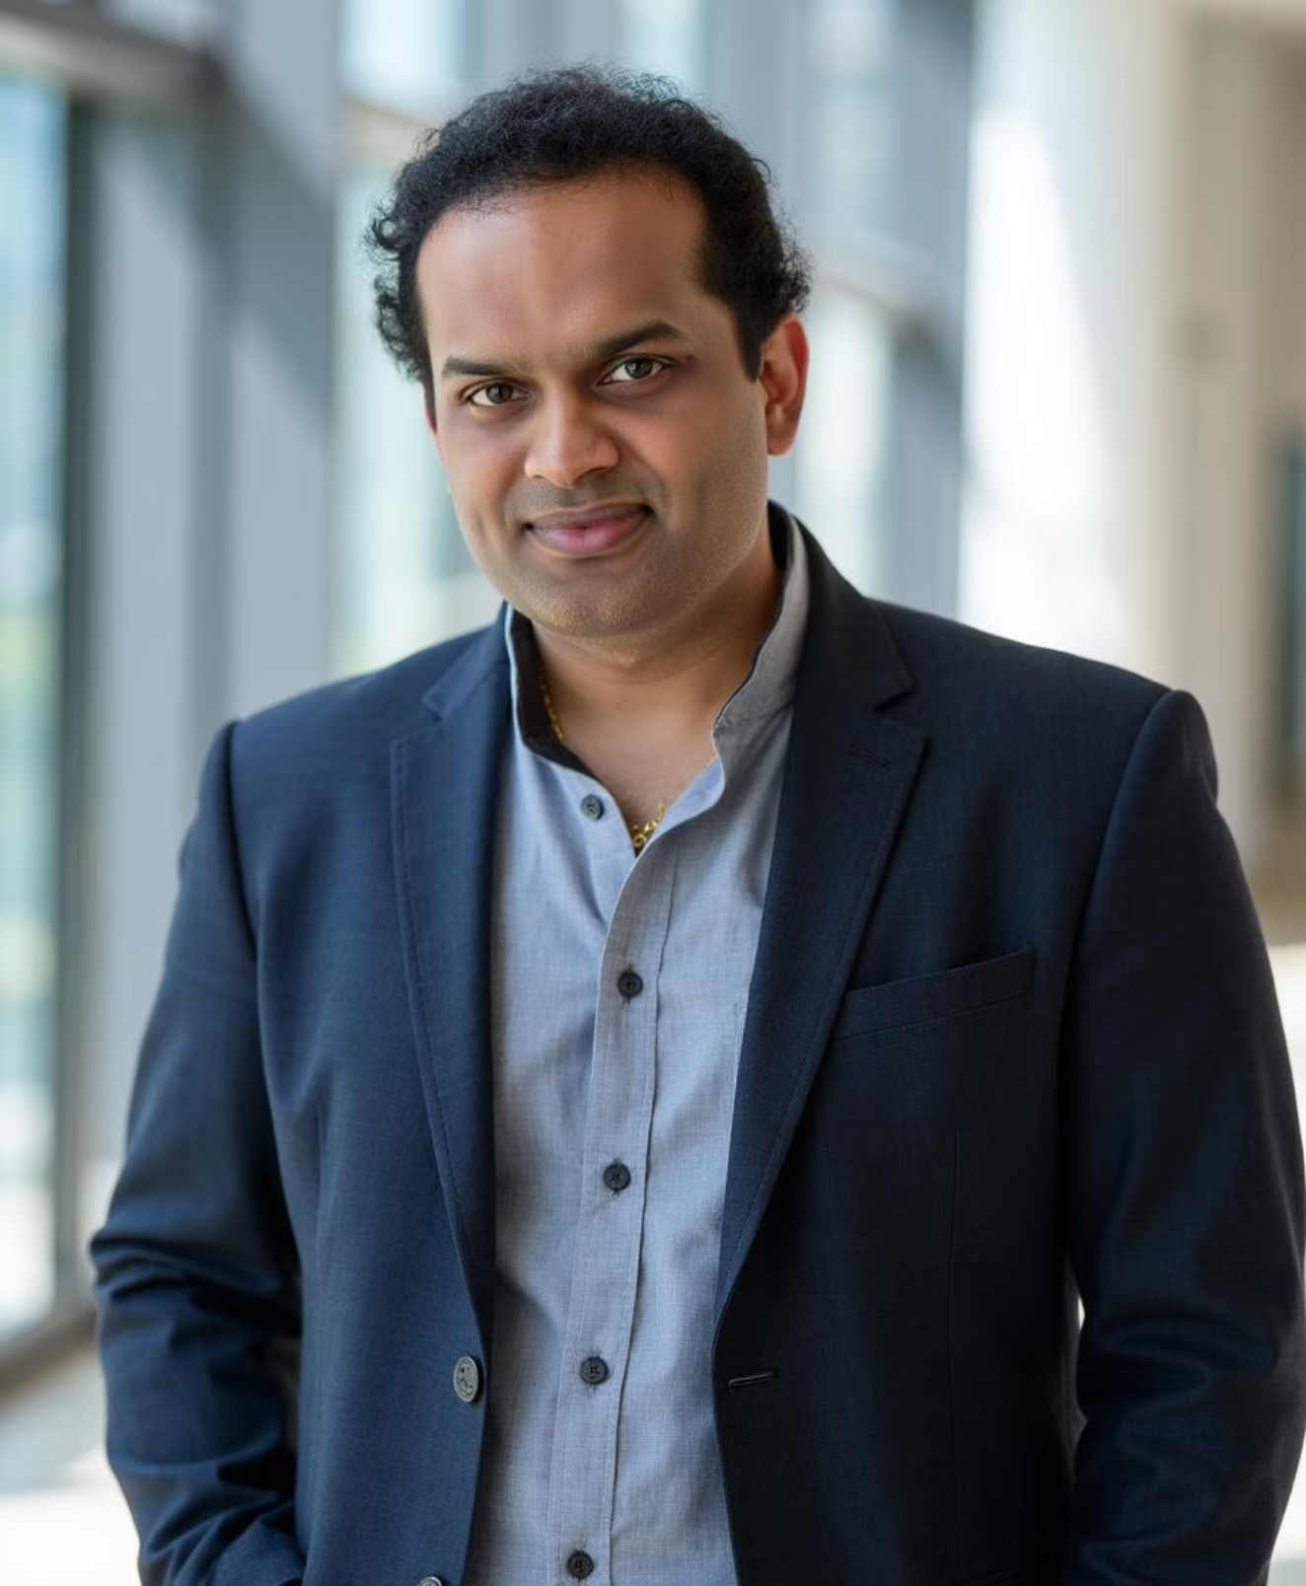
Meet the Innovator
Sreekanth Gopi
Founder & Developer
A prompt engineer in Research at a leading investment bank in the USA, Sreekanth's groundbreaking contributions to AI in mindfulness, music, and education have earned international recognition.
Top 30 Global Trailblazers 2025
Featured on Times Square billboards in New York
Top Prompt Engineer & AI Innovator
International Association of Top Professionals, Las Vegas

Slide 11

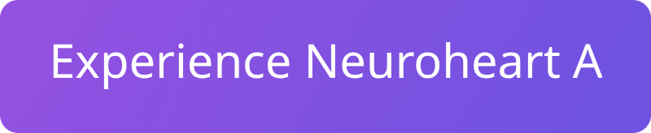
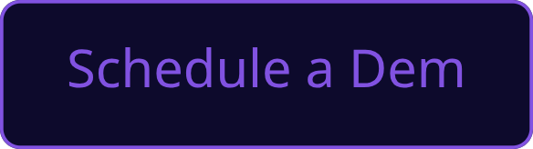
Transform Your Workplace Wellness
Join forward-thinking organizations investing in AI-powered mental wellness. Give your employees the tools they need to move from stress and burnout to clarity, balance, and peak performance.

